Slide 1
Tarun M
Team : tarun.mt_6994
EXL Hackathon :
A Smart BOT

Slide 2
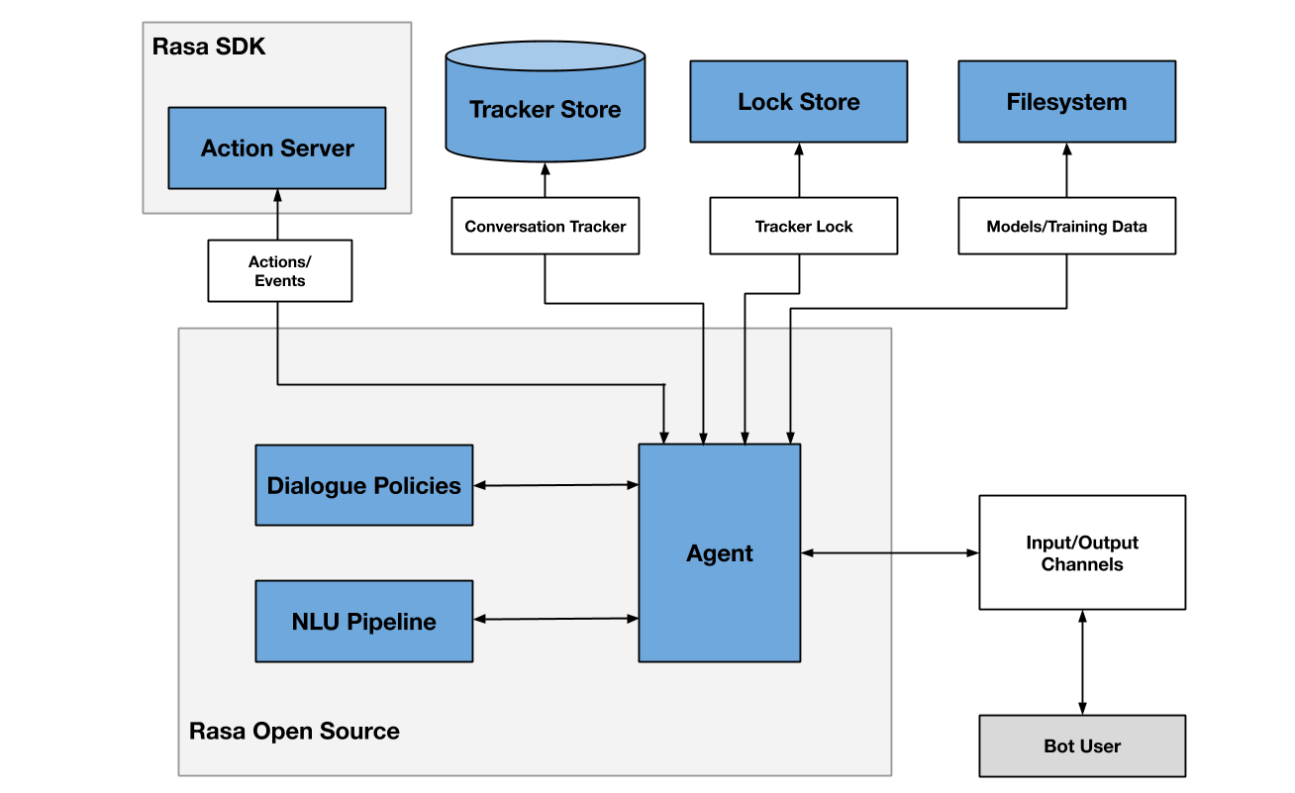

Solution Architecture
Haystack NLP Fallback server (FASTAPI)
When Questions not in Rasa trained model
Indexing pipeline
ElasticSearch (Opensearch)
Search pipeline
Retrieved answer and context
File Converter
Reteriver
DocumentStore
Pre processor
Reader
Recommendations System
Recommendations API response
React front-end UI
BotFront chatbot UI
User Interaction
RASA websocket

Slide 3
Technologies Used:
Deep learning Chatbot to perform natural conversation and can provide useful information and provide interactive usage for the end users :
React : Demo frontend web app. https://github.com/tarunmukku/exl-hackathon-web-form.git
Chatbot UI : Botfront https://github.com/botfront/rasa-webchat.git
Conversational AI : Rasa Opensource https://github.com/tarunmukku/exl-chatbot.git
haystack : NLP based Document search system for QnA fallback usage. https://github.com/tarunmukku/exl-chatbot.git
OpenSearch : Storage of document embeddings which is utilised via HayStack (hosted in AWS ) https://github.com/tarunmukku/exl-chatbot/blob/main/ElasticSearch_Setup.ipynb

Slide 4
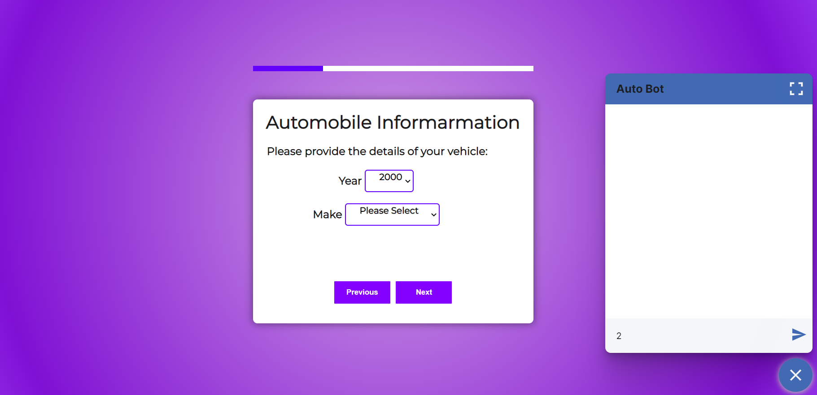
Methodology:
Web Application :
Sample demo web application form is
built using react and Node JS.
Chatbot front end UI is built
using BotFront.

Slide 5
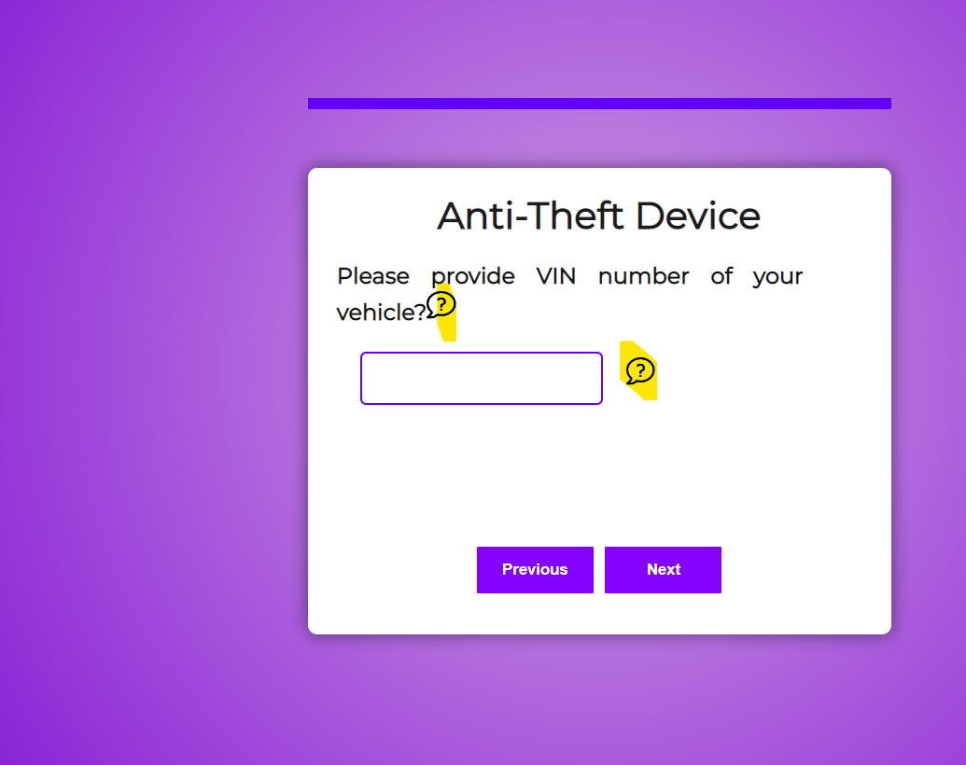
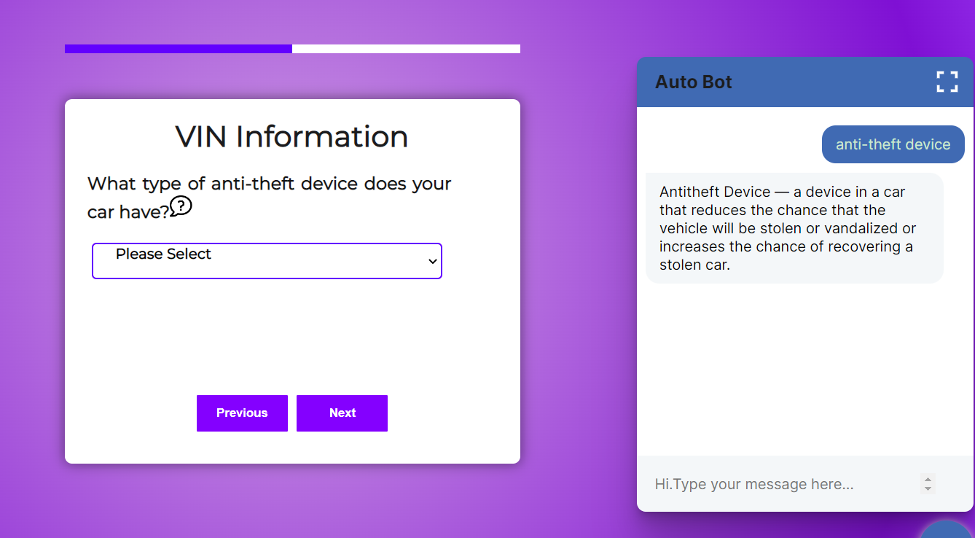
User Interactions with Chatbot
User can interact with the bot either by typing the chat window or click on the ‘?’ icon in the web page.
On clicking the ‘?’ icon a JavaScript is triggered, which initiates the chat for a particular field.

Slide 6
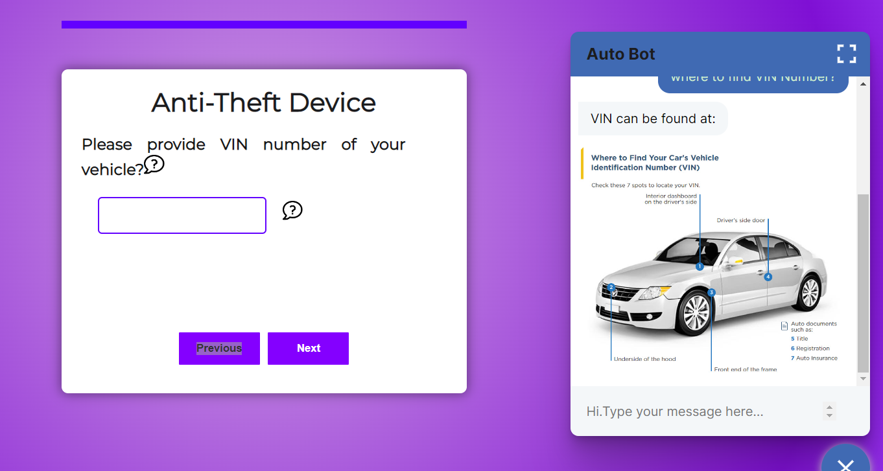
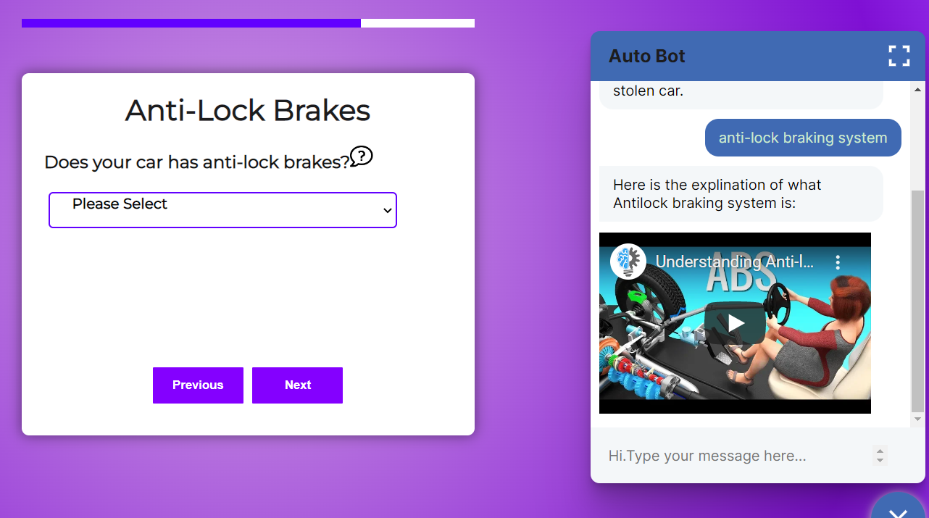
User Interactions with Chatbot (Contd. )
The responses for intents can also be of images or videos .

Slide 7
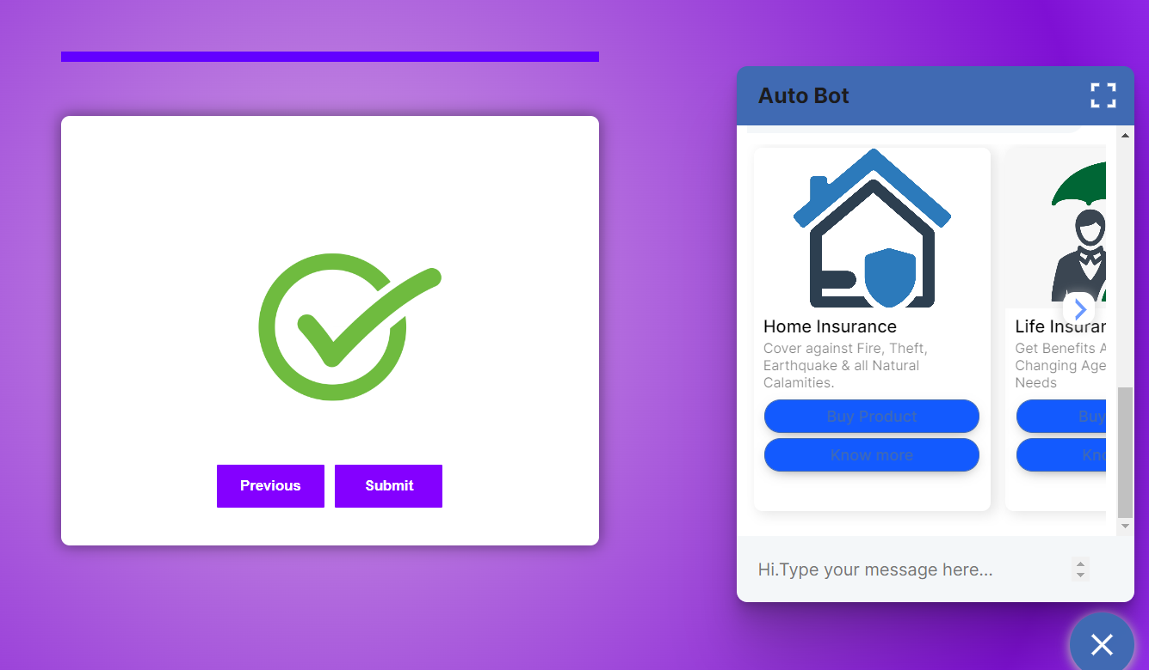
User Interactions with Chatbot (Contd. )
For product recommendations, the UI also shows up with interactive buttons and carousel for user interaction

Slide 8
RASA Opensource:
RASA NLU
RASA is used for NLU, Dialogue management, Entity extraction.
Deep learning Language model ‘Roberta’ is used for Intent Management and Entity extraction.
RASA model is based on pre-defined intents, utterances, entities, policies and other configurations.
RASA exposes a webSocket API which is consumed by the BotFront UI.
RASA also exposes REST API which can used to update conversation flows, configs, re-train and update the chatbot models. https://rasa.com/docs/rasa/pages/http-api
Actions Server
RASA utilises ‘Actions Server’ to perform custom actions based on user intents using
python code.
Actions server is also used to connect to 3rd party apps or other systems via REST API.
Product recommendations for cross-selling or upselling are fetched via actions server.
Actions server is also used in integrations to Haystack NLP framework search systems for ODQA.

Slide 9
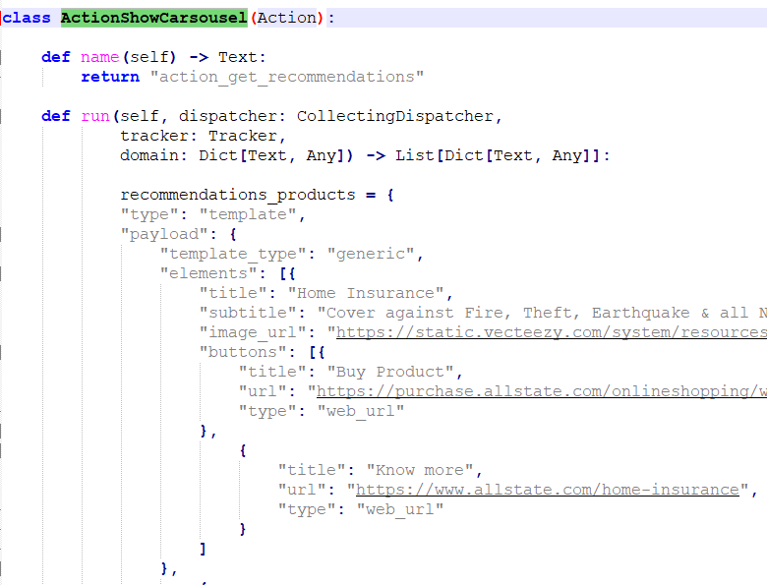
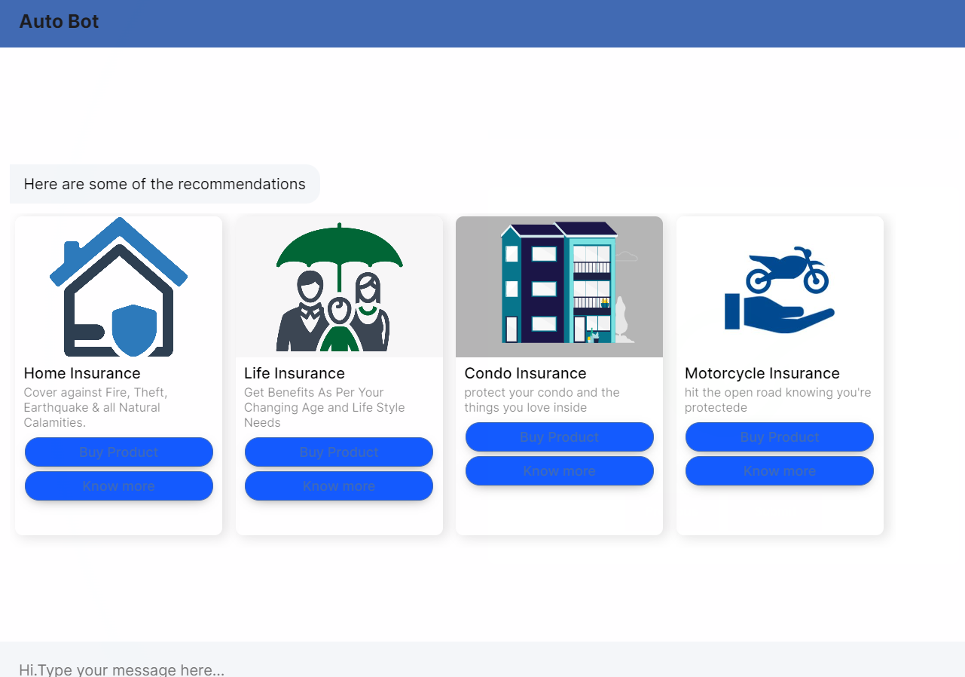
Product recommendations
RASA Interacts with Actions Server python class ‘ActionShowCarsousel’ in actions.py to get recommendations, currently it returns static json but can be fetch information as API.
Chatbot Font end UI(expanded)
Code snippet from actions.py

Slide 10
Fallback Server : Utilising Haystack NLP and Elasticsearch(OpenSearch)
For the questions which do not have pre-defined answers, RASA routes the query to HayStack NLP document search framework for answers ( via actions server).
HayStack uses ‘Retriever’ and ‘Reader’ objects to search and retrieve information from ElasticSearch (OpenSearch ).
Deep learning Dense Passage retriever (DPR) model is used for generating embeddings and retriever component.
For reader component ‘deepset/roberta-base-squad2’ beep learning model is used.

Slide 11
Business Considerations:
All the technologies which are utilised in the solution are open source and uses state-of-art technological approaches.
RASA NLU and Haystack uses transformer-based deep learning language models which be further fine-tuned or can be replaced to get higher performance and accuracy.
RASA provides complete SDK which can be used to create custom pipelines using python.
RASA also provides complete to deploy in Kubernetes cluster and to easily integrate to other components. https://github.com/RasaHQ/helm-charts/tree/main/charts/rasa

Slide 12
THANK YOU

